Slide 1
Snowflake - Objects
Tables
Temporary Tables
Exists through out the session
The data stored in the table contributes to the overall storage charges
Can Create temporary and non-temporary tables with the same name within the same schema.
Temporary table takes precedence in the session
create temporary table mytemptable (id number, creation_date date);
Drop table for dropping the Temporary Table
Transient Tables
Transient Tables persist until dropped explicitly
TT - similar to Permanent Tables but do not have Fail Safe Period
Transient Databases and Schemas can be created as well
visible to any user with the appropriate privileges
System Failure – TT may be lost

Slide 2
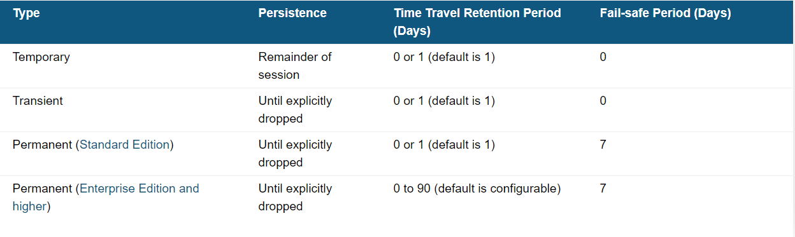
Snowflake - Objects
Tables Comparison
Transient tables do not have a Fail-safe period, they provide a good option for managing the cost of very large tables used to store transitory data

Slide 3
Snowflake - Objects
External Tables
External tables reference data files located in a cloud storage
External tables store file-level metadata about the data files such as the file path, a version identifier, and partitioning information
Query data files as if they were in snowflake
knowledge of the file format and record format of the source data files
All external tables include the following columns
VALUE: A VARIANT type column that represents a single row in the external file.
METADATA$FILENAME: A pseudocolumn that identifies the name of each staged data file included in the external table, including its path in the stage.
After External Table Creation manually execute Alter External Table .. Refresh Command
AUTO_REFRESH=TRUE
External table supports AWS S3, Azure and GCP External stages only
The VALUE column structures rows in a CSV data file as JSON objects with elements identified by column position, e.g. {c1: col_1_value, c2: col_2_value, c3: col_3_value ...}
External Tables – No Clustering, No Cloning, No Data Sharing, No XML Data, No Time Travel

Slide 4
Snowflake - Objects
External Table Creation
create stage my_s3_stage
storage_integration = s3_snowflake_int
url = 's3://sfdbbucket1/'
file_format = my_csv_format;
create or replace external table my_ext_customer with location = @my_s3_stage auto_refresh = true;
alter external table my_ext_customer refresh;
Drop external Table my_ext_customer;
The data is loaded into a Variant Column
For Querying the data use Value function -- select value:c1::String as c_cust_key , c_name from my_ext_customer a

Slide 5
Snowflake - Objects
Configuring External Table Auto-Refresh Using Amazon SQS
Step 1: Create a Stage (If Needed)
Step 2: Create an External Table
Step 3: Manually Refresh the External Table Metadata
Step 4: Configure Event Notifications
Step 5: Manually Refresh the External Table Metadata (Again)
Step 6: Configure Security
Limitations of External Table Auto-Refresh Using Amazon SQS
AWS limits the number of these notification queue configurations to a maximum of 100 per S3 bucket

Slide 6
Snowflake - Objects
Configuring External Table Auto-Refresh Using Amazon SQS
Step 1: Create a Stage (If Needed)
Step 2: Create an External Table
Step 3: Manually Refresh the External Table Metadata
Step 4: Configure Event Notifications
Desc External Tables - Show External Tables;
Copy Notification Channel Value from the described tables result set.
Log into AWS Console
Configure S3 Notification
Name: Name of the event notification (e.g. Auto-ingest Snowflake).
Events: Select the ObjectCreate (All) and ObjectRemoved options.
Send to: Select SQS Queue from the dropdown list.
SQS: Select Add SQS queue ARN from the dropdown list.
SQS queue ARN: Paste the SQS queue name from the SHOW EXTERNAL TABLES output.
Step 5: Manually Refresh the External Table Metadata (Again)
Step 6: Configure Security
Grant Select on External Table
Limitations of External Table Auto-Refresh Using Amazon SQS
AWS limits the number of these notification queue configurations to a maximum of 100 per S3 bucket

Slide 7
Snowflake - Objects
Hive And Snowflake External Table Creation
Connection Installation
Jdbc Setup
Validate
Table Creation in Hive

Slide 8
Snowflake – Views
Views
Regular View - Non-Materialized Views
Secured Views
Materialized Views
Advantages of Views
Encapsulation
Modularized Code
Expose Subset of Data
Materialized Views
Its more of table
Stores Data – Storage Charges Applied
Created if Complex Processing Logic is used
Created if Query Result wont change much or subset of results wont change much

Slide 9
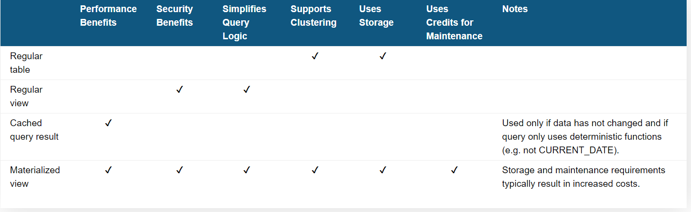
Snowflake – MVs
Materialized Views
Faster than Tables because of caching
Cache used for unchanged data set
Fetch results from table for the changed data set

Slide 10
Result Cache
Result Cache / Persisted Query Results
Caching the Query Results for result set re-use
Retention Period – 24 Hours
Max 31 Days from the First time Query is Executed
Each time the persisted result for a query is reused, Snowflake resets the 24-hour retention period for the result, up to a maximum of 31 days from the date and time that the query was first executed. After 31 days, the result is purged and the next time the query is submitted, a new result is generated and persisted
The Result Cache helps in building a cost-efficient cache layer in terms of compute and storage.
Session Parameter USE_CACHED_RESULT = true;
Query Results are Re-Used Based on the below Criteria
The user executing the query has the necessary access privileges for all the tables used in the query.
The new query syntactically matches the previously-executed query.
The table data contributing to the query result has not changed.
The persisted result for the previous query is still available.
The query does not include functions that must be evaluated at execution (e.g. CURRENT_TIMESTAMP).
The table’s micro-partitions have not changed (e.g. been re clustered or consolidated) due to changes to other data in the table.

Slide 11
Result Cache
Result_Scan Function for getting the Query Results from Cache → RESULT_SCAN ( { '<query_id>' | LAST_QUERY_ID() } )
Show Tables;
select $1 as value from values (1), (2), (3);
select "schema_name", "name" as "table_name", "rows" from table(result_scan(last_query_id())) where "rows" = 0;
Select * from table(result_scan(last_query_id())) where value > 1;
Retrieve All the Values from first Query in the session
select * from table(result_scan(last_query_id(1)));
Retrieve All the Values from second most recent query in the session
select * from table(result_scan(last_query_id(-2)));

Slide 12
Result Cache
Advantages
Results are stored irrespective of data changes in the base table. The query evaluation does not work there. If the base table has new rows which do not impact the earlier query result, the query won’t use the cached results. Instead, it will be re-executed.
It can help in the case of a complex query (i.e. queries with multiple joins) not performing as expected. These queries can be further broken down into multiple smaller components using the Result Cache’s features.
Eg: In a Proc Execute a complex query and re use the data for another processing logic
Limitations
There is a trade-off in terms of query performance and query result rows and size. Ideally, query result output should be small with regard to rows and size.
Snowflake does not keep any metadata for the Result Cache, and hence the result output in terms of rows and size does matter.
The query results (result scan function) cannot be accessed by other users. It is only accessible to the user who executed the query.
There is no metadata associated with the results, which is why a small data size and rows are preferred.
The default purge time of 24 hours for persisted results can be reset to 31 days only if we reuse the persisted results. The end date is calculated from the date and time that the query was first executed.

Slide 13
Materialized Views
A materialized view is a pre-computed data set derived from a query specification (the SELECT in the view definition) and stored for later use
When is a Materialized View is Used
Query results contain a small number of rows and/or columns relative to the base table (the table on which the view is defined).
Query results contain results that require significant processing, including:
Analysis of semi-structured data.
Aggregates that take a long time to calculate
Advantages
Materialized views are automatically and transparently maintained by Snowflake
Limitations
MV Can be Created on One Table Only.
SQL “INNER JOIN” are not supported.
The materialized view is typically slower than cached results. This is because the materialized view always provides current data, so if the materialized view is not up to date, it reads the up to date portion from the materialized view and rest of the data from the base tables.
The materialized view has storage and compute resource costs associated with it. The compute cost is due to the automatic internal maintenance of the materialized view by Snowflake.

Slide 14
Materialized Views
Limitations
A materialized view cannot query:
A materialized view.
A non-materialized view.
A UDTF (user-defined table function).
A materialized view cannot include:
UDFs.
Window functions.
HAVING clauses.
ORDER BY clause.
LIMIT clause.
GROUP BY keys that are not within the SELECT list. All GROUP BY keys in a materialized view must be part of the SELECT list.
Nesting of subqueries within a materialized view
These DML Ops are not allowed – COPY,DELETE,INSERT,MERGE,UPDATE
Snowflake’s “Time Travel” feature is not supported on materialized views

Slide 15
Materialized Views
MV- Creation
CREATE OR REPLACE MATERIALIZED VIEW MV_AGG_2001_Ql_DATA AS
SELECT
STSLS.SS_ITEM_SK, STSLS.SS_STORE_SK, STSLS.SS_CUSTOMER_SK, STSLS.SS_SOLD_DATE_SK, SUM(STSLS.SS NET PROFIT) NET PROFIT
FROM snowflake_sample_data.TPCDS_SFl00TCL.STORE_SALES STSLS
WHERE 1=1 AND STSLS.SS_SOLD_DATE_SK between 2451911 and 2452000 GROUP BY STSLS.SS_ITEM_SK, STSLS.SS_STORE_SK, STSLS.SS_CUSTOMER_SK, STSLS.SS_SOLD_DATE_SK;
Secure Materialized Views
CREATE OR REPLACE SECURE MATERIALIZED VIEW MV_AGG_2001_Ql_DATA AS
SELECT
STSLS.SS_ITEM_SK, STSLS.SS_STORE_SK, STSLS.SS_CUSTOMER_SK, STSLS.SS_SOLD_DATE_SK, SUM(STSLS.SS NET PROFIT) NET PROFIT
FROM snowflake_sample_data.TPCDS_SFl00TCL.STORE_SALES STSLS
WHERE 1=1 AND STSLS.SS_SOLD_DATE_SK between 2451911 and 2452000 GROUP BY STSLS.SS_ITEM_SK, STSLS.SS_STORE_SK, STSLS.SS_CUSTOMER_SK, STSLS.SS_SOLD_DATE_SK;
Alter MV
Rename - alter materialized view table1_mv rename to my_mv;
Cluster - alter materialized view my_mv cluster by<column_name>);
Suspend Clustering - alter materialized view my_mv suspend recluster;
Resume Clustering - alter materialized view my_mv resume recluster;
Suspend MV - alter materialized view my_mv suspend;
Resume MV - alter materialized view my_mv resume;
Drop MV
drop materialized view mv1;

Slide 16
Materialized Views
Compare – View / MV / Result Cache / CTAS
View - Response time – 3.50 mins
Result Cache – 317 ms
MV – 12.7 seconds First Time and 300 ms from next query on wards – MV result cache explaination
CTAS – Create Table As Select

Slide 17
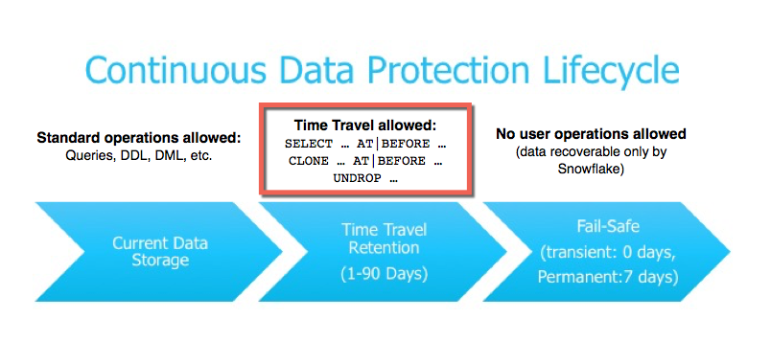
Snowflake – Time Travel
SF Time Travel Enables access to Historical Data ( Modified or Dropped / Deleted)
Advantages
Objects can be restored which were deleted or dropped
Data Analyzation during periods of time
Data duplication if need at particular periods of time

Slide 18
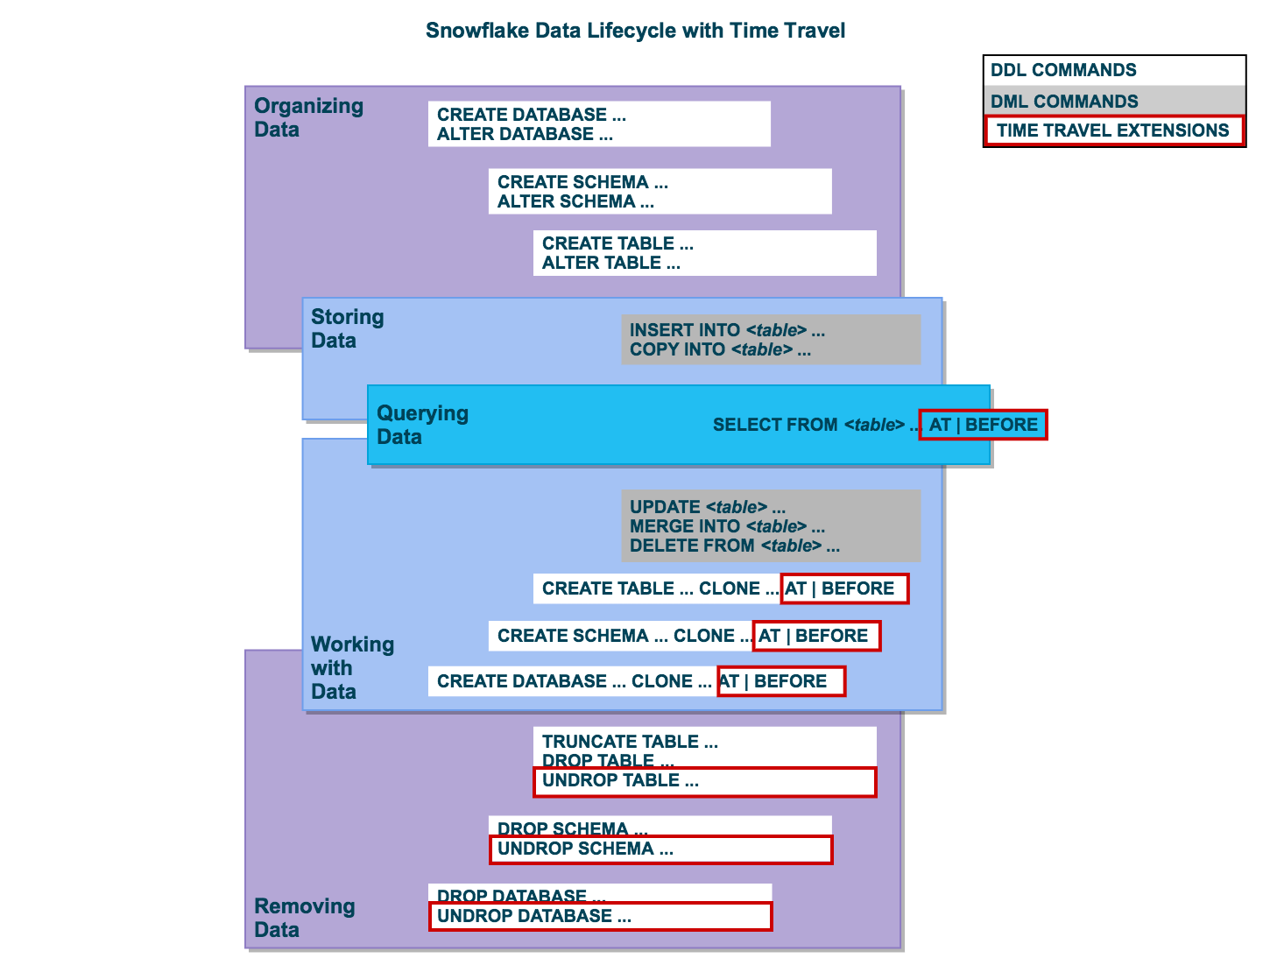
Snowflake – Time Travel
Time Travel SQL Constructs
AT / Before in SQL for object retrieval / access
Clone Command for data / object restoration
SQL Parameters – TIMESTAMP, OFFSET, STATEMENT
UNDROP command for tables, schemas, and databases.

Slide 19
Snowflake – Time Travel
Data Retention Period
The Standard Retention Period is 1 day / 24 Hours
Retention Period can be set to 0 on Account and Object Level (Database, Schema, Table) – TT Disabled
Enterprise Edition and Higher – Data Retention Period can be set to 0-90
The standard retention period is 1 day (24 hours) and is automatically enabled for all Snowflake accounts:
For Snowflake Standard Edition, the retention period can be set to 0 (or unset back to the default of 1 day) at the account and object level (i.e. databases, schemas, and tables).
A retention period of 0 days for an object effectively disables Time Travel for the object.
For Snowflake Enterprise Edition (and higher):
For transient databases, schemas, and tables, the retention period can be set to 0 (or unset back to the default of 1 day). The same is also true for temporary tables.
For permanent databases, schemas, and tables, the retention period can be set to any value from 0 up to 90 days.
When the retention period ends for an object, the historical data is moved into Snowflake Fail-safe:
Historical data is no longer available for querying.
Past objects can no longer be cloned.
Past objects that were dropped can no longer be restored.
To specify the data retention period for Time Travel:
The DATA_RETENTION_TIME_IN_DAYS object parameter can be used by users with the ACCOUNTADMIN role to set the default retention period for your account.
The same parameter can be used to explicitly override the default when creating a database, schema, and individual table.
The data retention period for a database, schema, or table can be changed at any time.

Slide 20
Snowflake – Time Travel
Data Retention Period
The ability to restore dropped objects with no retention period only persists for the length of the session in which the object was dropped. That is, once an object with no retention period is dropped, you will not be able to restore the object once the session ends.
General rule, we recommend maintaining a value of (at least) 1 day for any given object.
Examples
create table mytable(col1 number, col2 date) data_retention_time_in_days=90;
alter table mytable set data_retention_time_in_days=30
1) SHOW PARAMETERS like '%RETENTION%' in ACCOUNT; --DATA_RETENTION_TIME_IN_DAYS 2) use role ACCOUNTADMIN; 3) ALTER ACCOUNT SET DATA_RETENTION_TIME_IN_DAYS=0; 4) ALTER ACCOUNT UNSET DATA_RETENTION_TIME_IN_DAYS
Examples :
select * from my_table at(timestamp => 'Mon, 01 May 2015 16:20:00 -0700'::timestamp);
select * from my_table at(offset => -60*5);
select * from my_table before(statement => '8e5d0ca9-005e-44e6-b858-a8f5b37c5726’);
create table restored_table clone my_table at(timestamp => 'Mon, 09 May 2015 01:01:00 +0300'::timestamp);
create schema restored_schema clone my_schema at(offset => -3600);
create database restored_db clone my_db before(statement => '8e5d0ca9-005e-44e6-b858-a8f5b37c5726')

Slide 21
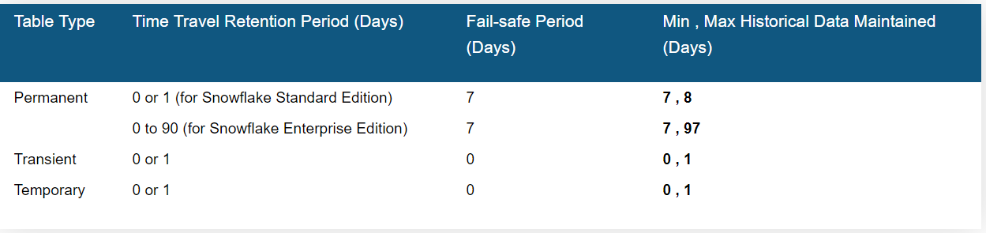
Snowflake – Time Travel
Undrop
undrop table mytable;
undrop schema myschema;
undrop database mydatabase;
History – Dropped Objects
show tables history like 'load%' in mytestdb.myschema;
show schemas history in mytestdb;
show databases history;
Storage Costs
Storage Fee charges for every 24 Hours

Slide 22
Snowflake – Time Travel
Dropping And Restoring :
Create table my_sales_tab_ver1(id number,descr varchar(100));
Create table my_fin_tab_ver1(id number, currency varchar(100));
insert into MY_SALES_TAB_VER1 values (100,'Electronics'), (200, 'Furniture'), (300,'Foot Wear');
Drop Table my_sales_tab_ver1;
show tables history;
Create table my_sales_tab_ver1(id number);
insert into my_sales_tab_ver1 values (1111), (2222), (3333), (4444);
drop table my_sales_tab_ver1 ;
create table my_sales_tab_ver1 (c1 varchar);
show tables history;
alter table my_sales_tab_ver1 rename to my_sales_tab_ver3;
undrop table my_sales_tab_ver1 ;
show tables history;
alter table my_sales_tab_ver1 rename to my_sales_tab_ver2;
undrop table my_sales_tab_ver1 ;

Slide 23
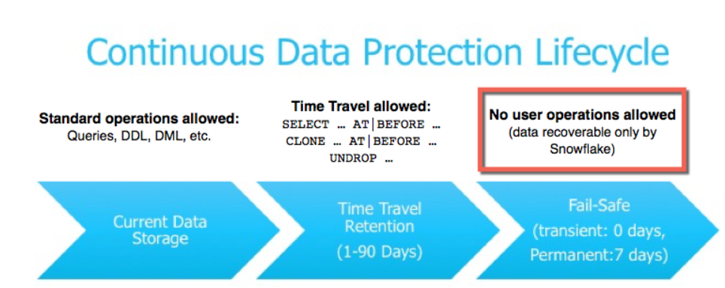
Snowflake – Time Travel
Fail Safe
Advantages
Fail-safe provides a (non-configurable) 7-day period during which historical data is recoverable by Snowflake
Fail-safe is not provided as a means for accessing historical data after the Time Travel retention period has ended.
It is for use only by Snowflake to recover data that may have been lost or damaged due to extreme operational failures

Slide 24
Snowflake – Time Travel
Why Fail Safe Instead of Backup
Data corruption or loss can happen with any database management
Full and incremental backups
Time required to reload lost data.
Business downtime during recovery.
Loss of data since the last backup.
Snowflake’s multi-data center, redundant architecture greatly reduces the need for traditional backup;
Fail-safe provides an efficient and cost-effective alternative to backup that eliminates the remaining risk

Slide 25
Snowflake – Data Sharing
Secure Data Sharing
Shares are named Snowflake objects that encapsulate all of the information required to share a database
No Data transfer happens or no new data is created
Snowflake data sharing happens through SF Metadata Layers and Global Services Layer
Providers : A data provider is any Snowflake account that creates shares and makes them available to other Snowflake accounts to consume
Consumers : A data consumer is any account that chooses to create a database from a share made available by a data provider
Reader Account: Share data with a consumer who does not already have a Snowflake account and/or is not ready to become a licensed Snowflake customer.

Slide 26
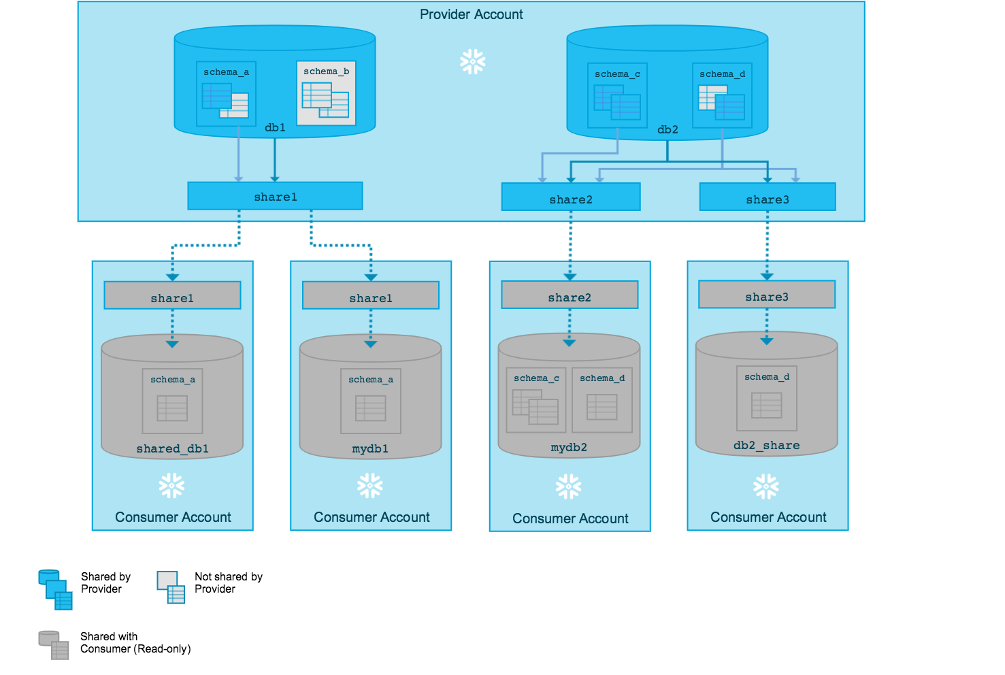
Snowflake – Data Sharing
Secure Data Sharing

Slide 27
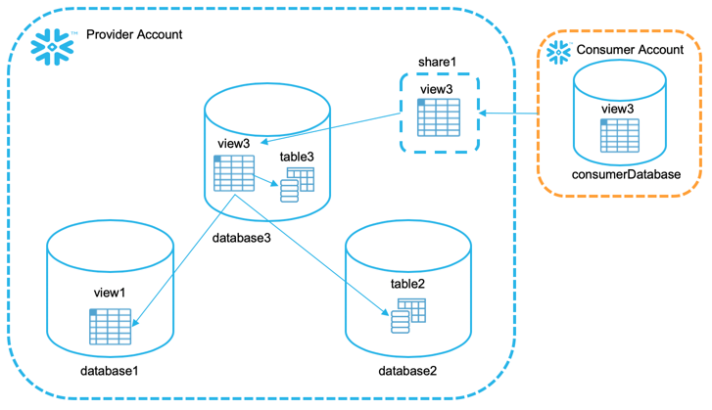
Snowflake – Data Sharing
Share
Create a Share
Add Objects to Share
Add Accounts to Share
Providers
Consumers
Sharing Data From Multiple Databases

Slide 28
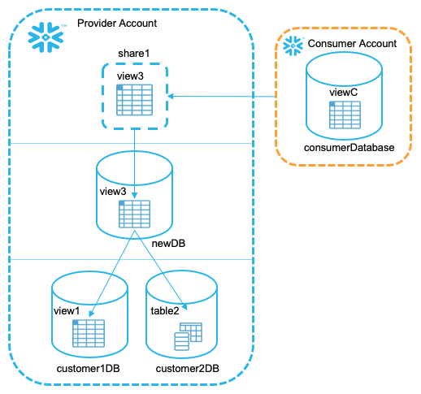
Snowflake – Data Sharing
Sharing Data From Multiple Databases

Slide 29
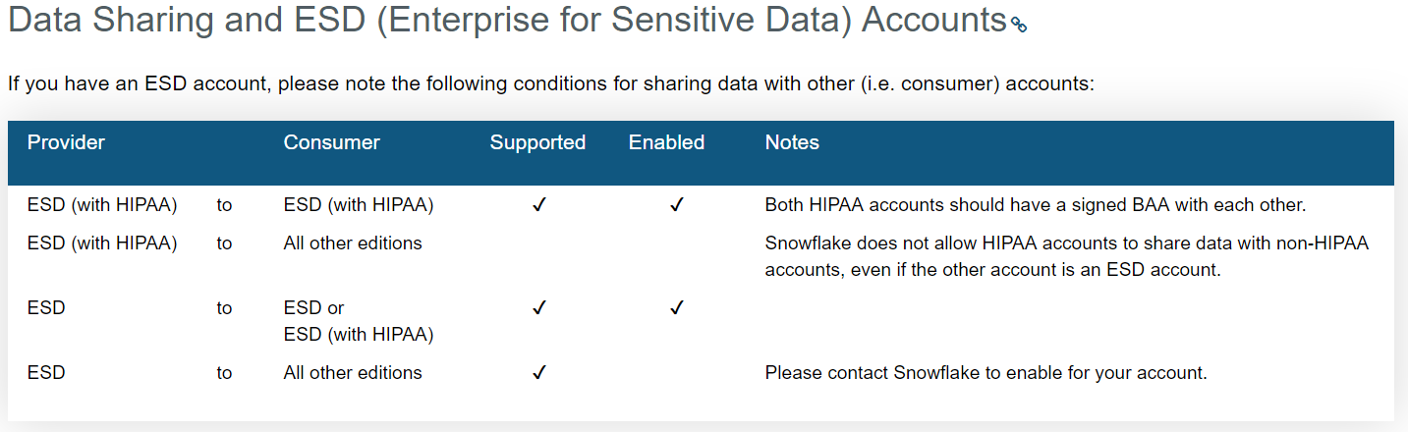
Snowflake – Data Sharing
Sharing Data Enterprise Editions
Do not share sensitive data with non-ESD accounts.
Consider creating a second, non-ESD account where you store less sensitive data and share this data with non-ESD accounts.
If you are using Tri-Secret Secure with your ESD account and you share data with other accounts, Snowflake treats the data access from these accounts as if the access occurred from within your own account. Specifically, granting access to the consumer account may require Snowflake to access your AWS KMS.

Slide 30
Snowflake – Data Sharing
Sharing Data
Web UI – Inbound , Outbound
Outbound Shares (Providers)
Shares that you have created and you have access to
Create a Share
Edit Shares
Inbound Shares (Consumers)
View Shares from providers that you are granted to
Create a Database for the share
Sharing Considerations
Currently, consumer accounts must be in the same Snowflake Region as your account; i.e. you can only share with other accounts in your Snowflake Region.
A share can include data from multiple databases.
For data security and privacy reasons, only secure views are supported in shares at this time. If a standard view is added to a share, Snowflake returns an error.
Adding accounts to a share immediately makes the share available to consume by the accounts.
New and modified rows in tables in a share (or in tables referenced by a view in a share) are available immediately to all consumers who have created a database from the share. Keep this in mind when updating these tables.
A new object created in a database in a share is not automatically available to consumers.

Slide 31
Snowflake – Data Sharing
Share DDLs
Create Share
Alter Share
Drop Share
Describe Share
Show Shares
Grant <Privileges> to Share
Revoke <Privileges> to Share
Show Grants to Share
Show Grants of Share
alter session set simulated_data_sharing_consumer='gt54793’;
Adding Accounts to a Share
alter share sales_s add accounts=xy12345, yz23456;
Removing Accounts From a Share
Alter share sales_s remove accounts=xy12345;
Dropping Share
Drop share sales_s;

Slide 32
Snowflake – Data Sharing
Consumers
AccountAdmin role to Import Shares
Any Account with IMPORT SHARES global Privilege can import Shares
General Limitations for Shared Databases
Shared databases are read-only. Users in a consumer account can view/query data, but cannot insert or update data, or create any objects in the database.
The following actions are not supported:
Creating a clone of a shared database or any schemas/tables in the database.
Time Travel for a shared database or any schemas/tables in the database.
Editing the comments for a shared database.
Viewing Available Shares
Web Interface : Click On shares – Inbound
SQL : Show Shares or desc Shares
Creating a Database from a Share
Web Interface : Click On Shares – In bound
Select the Share
Create Database From Share
create database snow_sales from share xy12345.sales_s;

Slide 33
Snowflake – Common Table Expressions
CTE – Common Table Expressions
Named Sub Query Defined with “WITH” clause
Temporary View
Eg: with MY_CTE (CTE_COL_1, CTE_COL_2) AS ( SELECT COL_1, COL_2 FROM ... ) select ... from my_cte;
Recursive CTE & Non Recursive CTE
Non Recursive CTE
select emps.title, emps.employee_id, mgrs.employee_id as manager_id, mgrs.title as "MANAGER TITLE" from employees as emps left outer join employees as mgrs on emps.manager_id = mgrs.employee_id order by mgrs.employee_id nulls first, emps.employee_id;
Recursive CTE
Anchor Clause and Recursive Clause
with recursive managers
(indent, employee_id, manager_id, employee_title)
as
(
-- Anchor Clause
select '' as indent, employee_id, manager_id, title as employee_title
from employees
where title = 'President'
union all
-- Recursive Clause
select indent || '--- ',
employees.employee_id, employees.manager_id, employees.title
from employees join managers
on employees.manager_id = managers.employee_id
)
select indent || employee_title as title, employee_id, manager_id
from managers

Slide 34
Snowflake – Common Table Expressions
Limit the Results in Recursive CTE
with recursive t(n) as
( select 1 union all select n + 1 from t )
select n from t limit 10;
Connect By , Prior - Works like Self Join
select employee_id, manager_id, title
from employees
start with title = 'President'
connect by
manager_id = prior employee_id
order by employee_id;
SYS_CONNECT_BY_PATH
select sys_connect_by_path(title, ' -> '), employee_id, manager_id, title
from employees
start with title = 'President'
connect by
manager_id = prior employee_id
order by employee_id;
Diff Between Self Join , CTE and Connect By Clauses
Connect By – like a Self join – no need to write
Recursive CTEs are more powerful.. Helps in Ordering , joining different tables ..
Connect by Cannot support ordering

